Slide 1
CS501 Team Presentation 1
Jan 31, 2023
Members: Melody Chan, Samantha Shih, Sarah Taaher Bonna

Slide 2

Favorite Apps - Instagram
Share photos and videos with followers
Followers either:
Make us feel like we are amazing (feeds our ego :D), or
Allows us to keep up with what our friends are doing

Slide 3

Favorite Apps - Netflix
Watch various shows legally for a small fee
Fresh content added periodically
Recommends shows based on your watch history
Has content produced exclusively for the platform

Slide 4

Favorite Apps - Amazon
E-commerce platform that sells almost everything
Easy and convenient to use
Platform for both sellers and buyers
Currently boasts free returns, though that is probably going to change

Slide 5

Favorite Apps - BeReal
Social media platform where everyone takes a photo at the same time during the day and posts it for friends to see.
Great for its simplicity and quick daily use

Slide 6

Favorite Apps - YouTube
Online video platform where people all around the world can upload and watch videos
Allows people to learn new things
Relaxing and entertaining

Slide 7
App Ideas
An app that hosts textbooks of different courses legally for free. Meant for students only. Need to upload proof of enrollment every year for free access. The textbooks can only be accessed in-app and cannot be downloaded or printed. This ensures that students are able to access the textbooks legally and potentially reduces the need for pirated content. For non-students, they have to pay a small fee per month to gain access to the textbooks.
An app that is easy to use and keeps track of produces in my fridge. I always find expired food that I forgot about in my fridge.
An app that helps the user explore new places while on a trip. The user will set a designated path and the app will recommend nearby places or restaurants to visit along the way.

Slide 8

Apps to Improve - Lyft
Pros:
Access a service in minutes
Can see the driver’s location as an animated car icon that is updated in real-time or at least near real-time
Has different modes of payment e.g. Credit/Debit cards, Apple Pay
Cons:
Cannot access the ride history without entering the location
Cannot pinpoint the user location manually
Should allow ride tracking to be shared on various platforms e.g. WhatsApp

Slide 9
App Design Challenge - Don’t Fleece Me Dude
Requirements of the app:
Phone camera integration
Allows customers to scan the receipt
Option to scan and input credit card information
Connection with the bank (API)
Receives notification from bank via the API of the amounts charged (total bill and tip)
Flags the transactions if there are any discrepancies

Slide 10
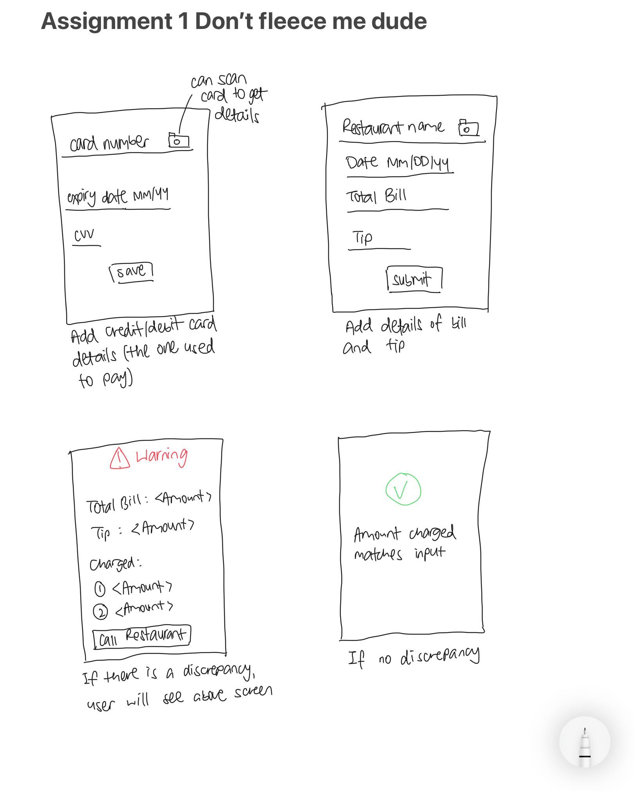
App Design Challenge - Don’t Fleece Me Dude

Slide 11
App Design Challenge - Don’t Fleece Me Dude

